Slide 1

NLP TECHNIQUES TO IDENTIFY INDIVIDUALS THAT ARE AT RISK OF SELF HARM
School of Computer Science and Engineering
NATURAL LANGUAGE PROCESSING (CSE4022) PROJECT COMPONENT
FINAL REVIEW REPORT
Submitted by
Team - 1
Nida Ghani - 20BCE2850
Tushar Singh - 20BCT0197
Arnab Mandal - 20BCE0026
Mayank Puri - 20BDS0256
Pulkit Sharma - 20BCE0615
Submitted To,
Sathyaraj R
17th November, 2023

Slide 2

ABSTRACT :
Suicide ideation is a critical mental health concern that poses a significant public health concern worldwide. Early detection of this type of ideation is crucial for timely intervention and support. Natural Language Processing (NLP) techniques have emerged as promising tools for automating the identification of suicide ideation in text data, such as social media posts, online forums, and chat transcripts. This project explores the application of the TF-IDF (Term Frequency - Inverse Document Frequency) NLP technique to detect and analyze suicide ideation in Tweets found from the social media platform Twitter. Furthermore, it is important to acknowledge that various mental health disorders, such as Borderline Personality Disorder or Chronic anxiety, often go unnoticed due to the lack of timely intervention. Therefore, this research not only focuses on suicide ideation detection but also highlights the broader implications of NLP, machine learning, and deep learning techniques in identifying and addressing a spectrum of mental health issues from digital life data.

Slide 3

INTRODUCTION :
Suicide ideation, the contemplation of self-harm or suicide, stands as a grave and pervasive public health concern, bearing profound consequences for both individuals and society as a whole. The awareness of mental health still remains to be a challenge as it is often very difficult to detect it. Timely identification and intervention are crucial in preventing suicide. Natural Language Processing (NLP), a field at the intersection of linguistics and artificial intelligence, offers promising tools to address this challenge by automating the detection of suicidal signals within text data.This project, "NLP Techniques to identify individuals that are at risk of self harm" is driven by the pressing need for innovative approaches to identify individuals at risk of suicide ideation through their written expressions. The prevalence of online communication platforms, such as social media, forums, and chat applications, has generated vast amounts of textual data that can provide valuable insights into individuals' mental health states. Leveraging NLP techniques, we aim to harness this data to create a proactive and efficient system for detecting signs of suicide ideation, ultimately facilitating timely intervention and support.

Slide 4
LITERATURE SURVEY :
Research Paper | Description
NLP for Suicide Risk Detection. | This paper reviews various studies on the use of Natural Language Processing (NLP) to detect suicidal ideation and behaviors from verbal expressions. It examines 31 selected studies from a pool of 9,711 candidates, primarily from English-language sources. The paper finds that NLP methods have shown strong potential in accurately identifying individuals at risk of suicide. However, the paper notes limitations such as non-standardized reporting, small sample sizes, and selection biases. The paper recommends further research to understand NLP's dissemination and implementation, aiming to improve suicide prevention efforts and reduce global suffering.
A Comparative Analysis on Suicidal Ideation Detection Using NLP, Machine, and Deep Learning. https://doi.org/10.3390/technologies10030057 | This paper conducts a comparative analysis of Machine Learning (ML) and Deep Learning (DL) models for detecting suicidal ideation in Twitter data. The study aims for accurate early detection and finds that a BiLSTM DL model performs the best, achieving 93.6% accuracy. The research bridges psychology and computer science and proposes future work in feature extraction techniques, imbalanced datasets, and real-world applications for mental health professionals.
Suicide ideation detection from online social media: A multi-modal feature based technique. | Those who are depressed or suicidal express themselves on social media. By analyzing online social media, this study's primary goal is to enable early suicide thought detection. Six feature groups that contained both online behaviors on social media and clinical suicidal symptoms were found in a well-labeled dataset of suicide ideas that was created on Reddit and Twitter. These feature groups are offered as a multimodal model for detecting suicidal thoughts on social media. The Logistic regression classifier outperformed other baselines with an accuracy of 87%. The study found that choosing and combining features effectively helps to achieve higher performance.

Slide 5
Research Papers | Description
A review of natural language processing in the identification of suicidal behavior https://doi.org/10.1016/j.jadr.2023.100507 | Free-form verbal expression in written and spoken form can be used to identify a variety of psychological problems using natural language processing (NLP) techniques. These technologies could be very helpful for identifying suicide risk and perhaps reducing world suffering. These techniques effectively enable for considerably faster computing of data at levels that people frequently find difficult to comprehend, which in certain situations results in better diagnostic accuracy and/or prognosis treatment success prediction.
Application of Natural Language Processing (NLP) in Detecting and Preventing Suicide Ideation: A Systematic Review https://www.mdpi.com/1660-4601/20/2/1514 | The paper was carried out in accordance with the PRISMA (Preferred Reporting Items for Systematic Reviews and Meta-analyses) standards to increase the level of transparency. The paper uses NLP techniques like text mining or text analytics and actively looks for keywords that might point at a hint like “mental health” OR disorder OR depression OR suicide OR psychotic OR psychiatry OR “self-harm” OR suicidal etc. The paper used datasets from PubMed, MEDLINE, Embase, PsycINFO, and Global Health through the OVID platform. Several papers discovered in the reference lists of the included studies were also included.
Detecting intimate partner violence circumstance for suicide https://injuryprevention.bmj.com/content/29/2/134.abstract | The paper aims to give a better understanding of IPV and related suicides. Close to 10,000 cases were selected as dataset to train the classification model using supervised ML. NLP techniques are used to extract information or key words and phrases. The model had robust sensitivity (0.70), specificity (0.98), precision (0.72) and kappa values (0.69). False positives mostly described other family violence. False negatives used vague and heterogeneous language to describe IPV, and often included abusive suicide threats.

Slide 6
Research Papers | Description
Suicidal Ideation Detection Application of Machine Learning Techniques on Twitter Data https://doi.org/10.1007/s11042-023-14431-z | The World Wide Web and online social networks have expanded the network connecting people, allowing for the rapid dissemination of information to large numbers of people. There are several instances of this kind of online collaborative contagion, one of which is the development of self-destructive ideas in social media sites like Twitter, which has caused alarm. In this investigation, the implications and findings of several machine classifiers that were applied to the point order of tweets and terms connected to suicide are discussed. The classifier can distinguish between more stressful information, such as suicidal creativity, other suicide-related topics, in-depth suicide-related facts, loyalty, campaign, and support. A simple classifier utilizing emotional, lexical, psychological, and structural characteristics from Twitter is used to link and identify allusions to suicide. This procedure makes use of clustering, bracketing, association rules, NLP (natural language processing), and numerous machine-learning techniques.
Natural language processing applied to mental illness detection: a narrative review https://doi.org/10.1038/s41746-022-00589-7 | The use of natural language processing (NLP) techniques shows promise in advancing proactive mental healthcare and facilitating early diagnosis. In order to comprehend methodologies, trends, obstacles, and future directions, we give a narrative assessment of mental illness detection using NLP over the last ten years. The review demonstrates an upward trend in NLP research on mental disorder identification. Traditional machine learning techniques are outperformed by deep learning techniques, which are given greater attention. Some suggestions for further research can be offered, such as the creation of fresh detection techniques, deep learning paradigms, and understandable models.

Slide 7
Research Papers | Description
Improvised solution for suicidal ideation using NLP https://www.nature.com/articles/s41598-022-19358-3#Sec2 | This study addresses the limitations of using diagnostic codes in Electronic Health Records (EHRs) to identify suicidal ideation and suicide attempts. Instead, it proposes a natural language processing (NLP) approach to enhance accuracy. Over 200 million clinical notes from the Vanderbilt EHR were processed using NLP to extract suicide-related query terms. A weakly supervised method was used to label cases of suicidal outcomes. The NLP validation showed high performance for both suicidal ideation and suicide attempt, with even better results when combining NLP with diagnostic codes and accounting for negated expressions in notes. The study highlights that scalable and accurate NLP methods can significantly improve the identification of suicidal behaviour in EHRs, benefiting prevention efforts, predictive models, and precision medicine.
Suicidal ideation using Deep Learning Algorithms https://www.mdpi.com/2227-7080/10/3/57 | This paper highlights the problem of suicide, especially among young and middle-aged individuals, and how social media data, particularly tweets, can aid in the early detection of suicidal thoughts. It emphasizes the challenges posed by societal stigma. Machine Learning (ML) and Deep Learning (DL) techniques are suggested for identifying suicidal thoughts in tweets due to their effectiveness. Previous research used small datasets, resulting in poor accuracy. The authors collected a dataset of about 50,000 tweets, labelled as suicidal or non-suicidal using sentiment analysis. Various preprocessing steps cleaned the text. DL models consistently outperformed ML models in identifying suicidal tweets. Word cloud analysis highlighted vocabulary differences between suicidal and non-suicidal tweets. Cross-validation assessed ML models, and model validation optimized DL models.

Slide 8
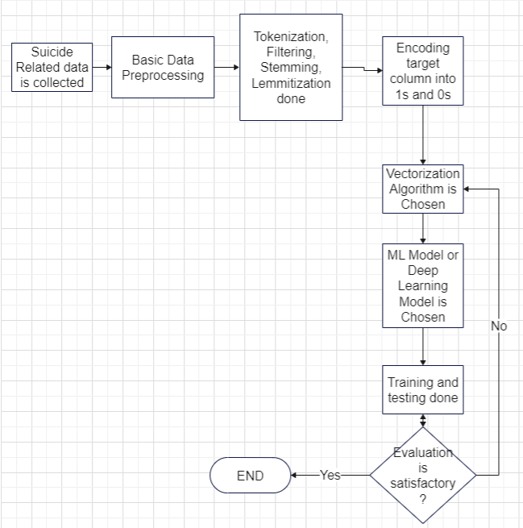
ARCHITECTURE DIAGRAM :

Slide 9

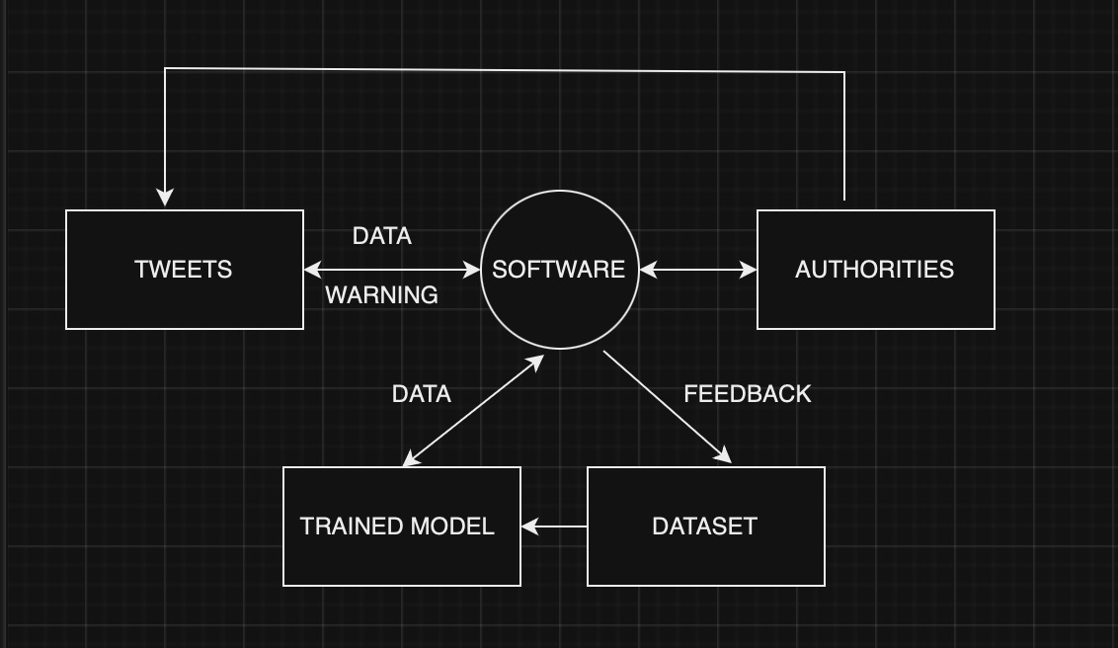
DATA FLOW DIAGRAM :
LEVEL 0:
LEVEL 1:

